Slide 1
Health and Emergency Management in School Settings
November 2018

Slide 2
Overview
Education Laws/regulations governing public school health services
Office of Children and Family Services and licensed SACC programs

Slide 3
Laws Impacting School Health Services
Federal Laws
State Laws
FERPA – Family Educational Rights and Privacy Act USDOE Family Compliance Office
HIPAA- Health Insurance Portability and Accountability Act
USHHS- Health Privacy Information
IDEA-Individuals with Disabilities Act USDOE- IDEA
ADA-Americans with Disabilities Act, Section 504 USDOE- Civil Rights
Education Law Article 19
Education Law Articles 139 , 137, and 131
Public Health Law Section 2164
Public Health Law Section 3000

Slide 4
School Health Services
Education Law Article 19 section 901, School health services include but are not limited to:
Medical examinations
Scoliosis screening
Vision screening and audiometer tests
Inform parents or other persons in parental relation to the student, pupils and teachers of the individual student's health condition subject to Federal and State confidentiality laws
Guide parents, students and teachers in procedures for preventing and correcting defects and diseases
Instruct the school personnel in procedures to take in case of accident or illness
Survey and make necessary recommendations concerning the health and safety aspects of school facilities and the provision of health information

Slide 5

Education Law Article 19 section 902 requires school districts to employ a director of school health services, (commonly referred to as the medical director) to oversee school health services
A medical director must be a duly licensed physician or nurse practitioner

Slide 6
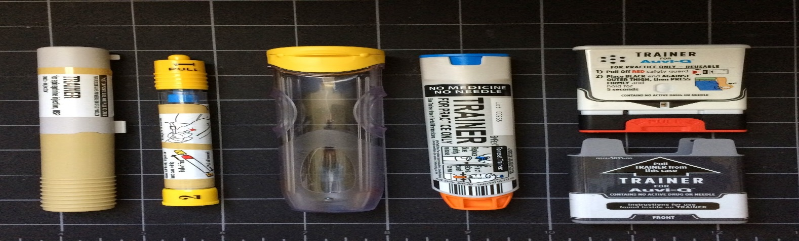
Epinephrine Auto-injectors
Student or staff in the building:
Students with provider orders:
Unlicensed staff trained per District protocol may administer epinephrine auto-injectors in the event of an emergency pursuant to the requirements of section 3000-c of the public health law to any student or staff in a school building having anaphylactic symptoms – whether or not there is a previous history of severe allergic reaction.
Unlicensed staff trained by RN, NP, PA or physician MD/DO may administer an epinephrine auto-injector to a specific student during the school day on school property and at any school function, in emergency situations, where an appropriately licensed health professional is not available in accordance with the provider’s order.

Slide 7
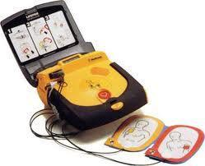
Automatic External Defibrillators (AED)
Required in all public schools and at school sponsored events.
PAD application must be filed with regional EMS office. Requires a collaborative agreement with an emergency health care provider; a physician, NP, or PA certified in emergency medicine
Staff currently certified in CPR/AED must be on site during school day and at school sponsored events
Use of an AED must be reported to regional EMS office.
AED must be maintained and checked on a regular basis to ensure function.

Slide 8
School Emergency Drills
School emergency drill planning should include how to meet student chronic health needs during lockdowns.
Students with diabetes will need access to glucose replacement. Classrooms can store juice boxes etc. for this purpose
Students with asthma should carry their inhalers with them
Cell phones carried by teachers may alert authorities to a health emergency.
Epinephrine auto-injectors should be kept as close to the student as possible.
Basic First Aid supplies in each room with staff instructed how to use, and written prompts ( e.g. gauze, gloves, tape, bandaids)

Slide 9
Office of Children and Family Services
Programs with licensed by OCFS should contact them for information on how they are to handle health emergencies.
NYS OCFS Division of Childcare Services (Home Office)
(518) 474-9454

Slide 10
NYS Education Department
Karen Hollowood
Martha Morrissey
Associates in School Nursing
518-486-6090
studentsupportservices@nysed.gov

