Slide 1
The New York State Education Department Transition Regents Examination in
Global History & Geography – Grade 10

Slide 2
Dates for Transition Regents Examination in Global History and Geography – Grade 10
First administration June 2018
Last administration June 2020

Slide 3
Format Comparison of Global History and Geography Regents Exams
Previous Global Design
(grade 9–10);
Last administration
January 2018
Transition Global Design
(grade 10);
First administration
June 2018
50 Multiple-Choice Questions
1 Thematic Essay
1 Document-Based Essay
30 Multiple-Choice Questions
1 Thematic Essay
1 Document-Based Essay
Notes:
This is a DRAFT of the Global Regents.
A point to highlight is that primary and secondary sources are used in EVERY part of the exam.
This draft design was used to gather feedback from the field…next slide.

Slide 4
Components and Weighting of Global History and Geography Examinations
Previous Global (9/10)
Item Types | No. of Items | Approximate Weighting
MCQs | 50 | 55%
THM | 1 | 15%
SCF | 11–14 | 15%
DBQ | 1 | 15%
Global Transition (10 only)
Item Types | No. of Items | Approximate Weighting
MCQs | 30 | 55%
THM | 1 | 15%
SCF | 11–14 | 15%
DBQ | 1 | 15%

Slide 5
Components and Raw Points Available for Transition Regents Examination in Global History and Geography – Grade 10
Part | Question Type | Number of Questions | Raw-Score Credits Available for Each Question | Total Number of Raw-Score Credits
I | Multiple-Choice | 30 | 0 or 2 | 60
II | Thematic Essay | 1 | 0, 0.5, 1.0, 1.5, 2.0, 2.5, 3.0, 3.5, 4.0, 4.5, or 5 | 5
III A | DBQ Scaffolding | 11-14 | 0, 1, or 2 | 11-14
III B | DBQ essay | 1 | 0, 0.5, 1.0, 1.5, 2.0, 2.5, 3.0, 3.5, 4.0, 4.5, or 5 | 5

Slide 6
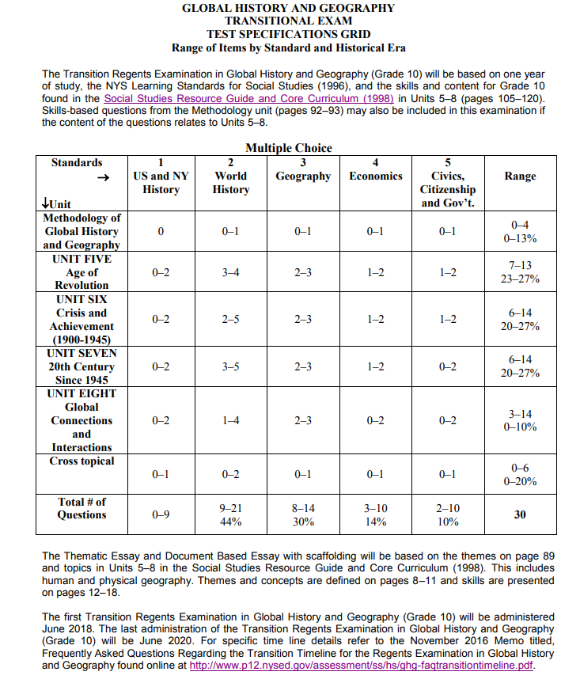

Slide 7
Links to Documents
NYS Social Studies Resource Guide and Core Curriculum
http://www.nysed.gov/curriculum-instruction/social-studies-resource-guide-and-core-curriculum-1998
NYS Learning Standards for Social Studies
http://www.nysed.gov/common/nysed/files/sslearn.pdf
Frequently Asked Questions Memo (November 2016)
http://www.p12.nysed.gov/assessment/ss/hs/ghg-faqtransitiontimeline.pdf
Specifications Grid for Transition Regents Examination
http://www.p12.nysed.gov/assessment/ss/hs/ghg-transitionspecificationgrid.pdf

