Slide 1
Demonstrable Improvement for 2017-18
Presented by
Ira Schwartz & Shibu Joseph
December 13, 2017

Slide 2
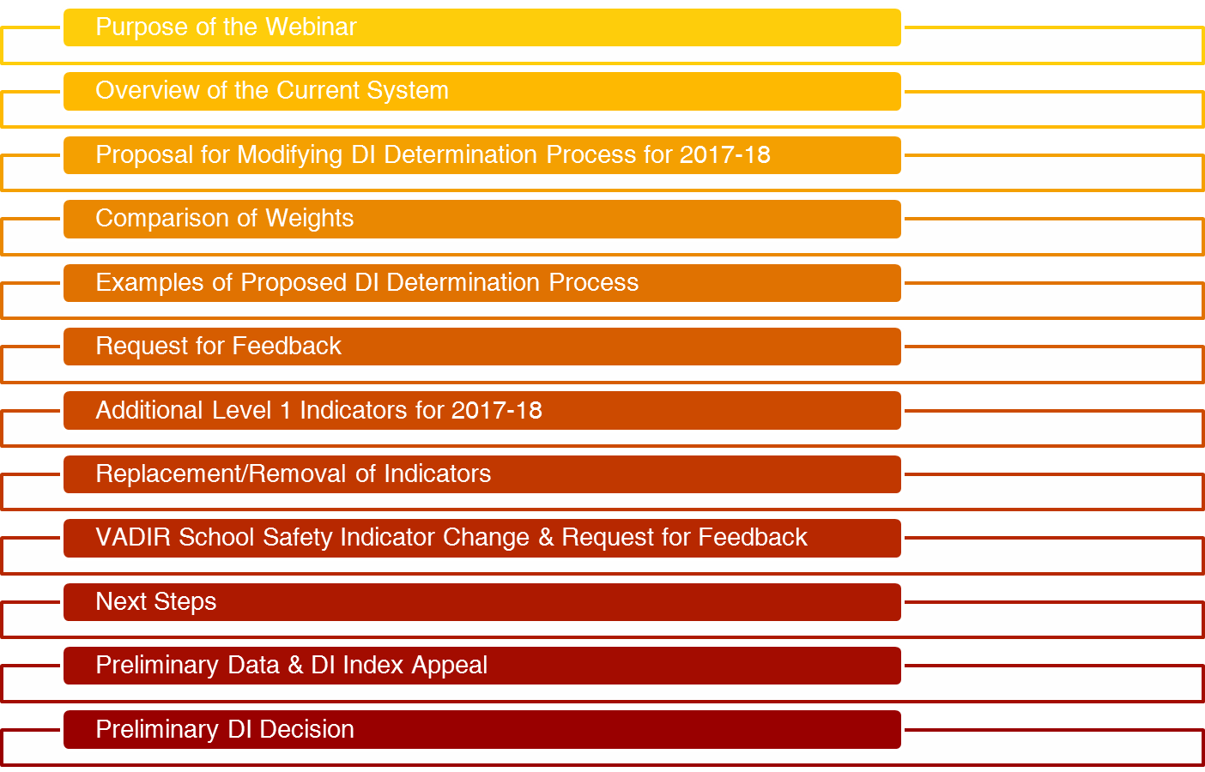
Overview

Slide 3
Purpose of the Webinar
Provide an overview of the current system.
Review the process the New York State Education Department (NYSED) will follow to determine Demonstrable Improvement (DI) for 2017-18.
Review a proposal for how to use ESSA designations as part of the DI process.
Provide examples of how the proposal would work.
Request feedback on the revised weighting proposal and any alternative ideas.
Discuss the assignment of new Level 1 indicators and the ability to request revisions to the indicators for a school.
Review changes to VADIR School Safety Indicator and request feedback.
Identify next steps & address questions.

Slide 4
Questions
Please e-mail questions on Demonstrable Improvement to accountinfo@nysed.gov.

Slide 5
DI Indicators, Goals & Progress Targets
Most indicators are based on student performance; some indicators are based on implementation of programs and/or processes.
Districts were allowed to submit local measures as DI Indicators.
Level 1 DI indicators were selected by the Department, if the school’s baseline performance was below the 2015-16 goals and needed the most improvement.
Level 2 indicators were selected by the district in performance or program areas where the school’s baseline performance was below the 2015-16 goals.

Slide 6
DI Indicator Goals & Progress Targets
The yearly goal is to reduce the gap between Receivership Schools and the state average by 1/6, ¼ and by ½ for the 2015-16, 2016-17 and 2017-18 school years.
The yearly progress target is set based on a minimum change from the school’s baseline performance.
The progress targets in general increase from one percent in 2015-16 to six percent in 2017-18.
For each indicator, a school can make progress by achieving either the goal or the school specific progress target.

Slide 7
DI Indicator Goals & Progress Targets: Examples
Indicator | School’s Baseline | 2015-16 Goal | 2015-16 Progress Target | 2016-17 Goal | 2016-17 Progress Target | 2017-18 Goal | 2017-18 Progress Target
Grades 3-8 ELA All Students Level 2 & above | 26% | 40% | 27% | 42% | 29% | 51% | 32%
Grades 3-8 Math Black Students MGP | 41.79 | 48.96 | 42.79 | 48.96 | 42.79 | 48.96 | 43.79
Total Cohort Passing ELA Regents | 18% | 51% | 19% | 53% | 21% | 61% | 24%
4-Year Grad Rate - All Students | 26% | 55% | 27% | 57% | 29% | 64% | 32%

Slide 8
The Level 1 Indicators
Elementary and Middle:
Making Priority School Progress
Percent of Students at or above Level 2 in ELA
Percent of Students at or above Level 2 in math
Mean Student Growth Percentile in ELA
Mean Student Growth Percentile in math
Percent of Students at or Above Level 3 in Science
Serious Incidents (VADIR)
High School:
Making Priority School Progress
4-year High School Graduation Rate
5-year High School Graduation Rate
Percent of Students Graduating with Regents Diploma with Advanced Designation
Percent of 10th graders passing Math Regents
Percent of 11th graders passing ELA Regents
Serious Incidents (VADIR)

Slide 9
Level 2 Indicators
Level 2 Indicators Include:
  Indicators for students subgroups (i.e., English language learners, low-income students, racial/ethnic groups and students with disabilities).
  Implementing a Community School Model, expanded learning time and other key system initiatives.
  School climate (i.e., attendance, suspensions).
  Gaps between a student group and students who are not members of the group (e.g., between students with disabilities and students without disabilities).
  Students passing courses.
  High School Student Promotion Rates (promoted from grades 9,10 & 11).
  College- and Career- Readiness.
  Developmentally Appropriate Child Assessments: Pre-K to Third Grades.
  Teachers Teaching out of Certification Area.
  Teacher Turnover.
  Post-graduation plans for students.
  Local measures approved by the Commissioner.

Slide 10
Computation of a DI Index
Level 1 indicators are weighted at 50% in computing the Demonstrable Improvement Index and Level 2 indicators are also weighted at 50%.
Each indicator within Level 1 and Level 2 are weighted equally.
The Demonstrable Improvement Index shall range from 0% to 100%.
If the school achieves an index of 67% or higher, the school is preliminarily determined to have made Demonstrable Improvement. If the school achieves below 40%, the school is preliminarily determined to have not made Demonstrable Improvement. This designation can be revised if the school can demonstrate it would have achieved 67% of its goals absent extenuating or extraordinary circumstances.
The Commissioner reviews the entirety of the record to determine whether a school with an index of 40% or higher and less than 67% shall be preliminarily determined to have made Demonstrable Improvement.
Final determinations are made after the Commissioner has consulted with the receiver, the principal, the head of the local collective bargaining unit representing teachers, and the chair of the Community Engagement team.

Slide 11
Computing the Demonstrable
Improvement Index: Example
Indicator | Level | Performance | Progress Target | Indicator Made | Weighting
Priority School makes yearly progress | Level 1 | Made Progress | Make Progress | Yes | 7.14%
3-8 ELA All Students MGP | Level 1 | 54.90 | 40.32 | Yes | 7.14%
3-8 Math All Students MGP | Level 1 | 47.68 | 34.99 | Yes | 7.14%
3-8 Math All Students Level 2 and above | Level 1 | 46% | 37% | Yes | 7.14%
3-8 ELA All Students Level 2 & above | Level 1 | 45% | 29% | Yes | 7.14%
NWEA Reading Growth | Level 1 | 40.4% | 53.7% | No | 0%
NWEA Math Growth | Level 1 | 44.4% | 49.8% | No | 0%
Teacher Practices and Decisions (DTSDE Tenet 4) | Level 2 | Stage 2 | Stage 2 | Yes | 10
3-8 Math Black Students Level 2 and above | Level 2 | 38% | 34% | Yes | 10
Teacher Attendance | Level 2 | 100% | 96% | Yes | 10
Chronic Absenteeism | Level 2 | Met Rubric | Meet Rubric | Yes | 10
3-8 Math ED Students Level 2 and above | Level 2 | 48% | 36% | Yes | 10
Index Result |  |  |  |  | 86%

Slide 12
DI Status for 2016-17
Data for DI indicators were collected during May to August 2017.
Early September 2017: NYSED informed districts whether the indicators met the progress target or goal, and also the preliminary DI Index score. The data behind the calculations was also shared.
Mid September 2017: Districts appealed the indicator data or the DI Index score by September 15, 2017.
Early October 2017: NYSED informed districts about the preliminary DI status based on 2015-16 and 2016-17 DI Index.
Early October 2017: NYSED then informed stakeholders about the preliminary DI status. Stakeholders were asked to submit a “Demonstrable Improvement Determination Consultation and Collaboration Form” by October 13, 2017.
Late October 2017: Stakeholders and the public were informed of the final DI status.
Schools failing to make DI were required to appoint an Independent Receiver with the approval of the Commissioner or submit a closure plan.

Slide 13
Proposal for Modifying Demonstrable Improvement Determination Process for 2017-18
All current DI indicators, except Indicator #1: Make Priority School Progress, will remain in place.
Any Level 1 indicator for which a school falls below the 2017-18 goal will be newly assigned to the school.
The weighting of indicators will be modified as follows:
  A school will receive 50 points if the school is identified as a School In Good Standing under ESSA.
  A school will receive 25 points if the school is identified as a Targeted Support and Improvement School (TSI) under ESSA.
  A school will receive 0 points if it is identified as a Comprehensive Support and Improvement (CSI) School.
Level 1 Indicators will be weighted 25%.
Level 2 Indicators will be weighted 25%.

Slide 14
Comparison of Weights: 2016-17 to 2017-18
 | Current System | Proposed System
Level 1 | 50% | 25%
Level 2 | 50% | 25%
ESSA Status | - | 50%
Accountability Status | Weight
Good Standing | 50
Targeted Support & Improvement (TSI) | 25
Comprehensive Support & Improvement (CSI) | 0

Slide 15
Examples of Proposed DI Determination Process
Example #1
Category | Number of Indicators | Number Met | Points
Level 1 | 4 | 3 | .75 X .25 = 19
Level 2 | 8 | 4 | .5 X .25 = 13
ESSA Status | Good Standing |  | 50
DI Status | Made DI |  | 82

Slide 16
Examples of Proposed DI Determination Process
Example #2
Category | Number of Indicators | Number Met | Points
Level 1 | 4 | 4 | 1 X .25 = 25
Level 2 | 8 | 6 | .75 X .25 = 19
ESSA Status | Targeted Support and Improvement |  | 25
Preliminary DI Status | Made DI |  | 69

Slide 17
Examples of Proposed DI Determination Process
Example #3
Category | Number of Indicators | Number Met | Points
Level 1 | 4 | 4 | 1 X .25 = 25
Level 2 | 8 | 6 | .75 X .25 = 19
ESSA Status | Comprehensive Support and Improvement |  | 0
Preliminary DI Status | Commissioner’s Decision |  | 44

Slide 18
Examples of Proposed DI Determination Process
Example #4
Category | Number of Indicators | Number Met | Points
Level 1 | 4 | 3 | .75 X .25 = 19
Level 2 | 8 | 4 | .5 X .25 = 13
ESSA Status | Comprehensive Support and Improvement |  | 0
Preliminary DI Status | Did Not Make DI |  | 32

Slide 19
Examples of Proposed DI Determination Process
Example #5
Category | Number of Indicators | Number Met | Points
Level 1 | 4 | 0 | 0 X .25 =0
Level 2 | 8 | 2 | .25 X .25 = 6
ESSA Status | Good Standing |  | 50
DI Preliminary Status | Commissioner’s Decision |  | 56

Slide 20
Request for Feedback
Do you support the proposal for modifying Demonstrable Improvement determination process for 2017-18?
  If yes, are the weightings appropriate?
  If no, what other suggestions should we consider?
Please e-mail comments on the proposal for modifying the DI Determination process to accountinfo@nysed.gov no later than Thursday, December 21, 2017.

Slide 21
Additional Level 1 Indicators for 2017-18
If the school’s 2016-17 performance is below the 2017-18 statewide goal for an indicator, the indicator will be added as an additional Level 1 indicator.
NYSED will inform districts of the new Level 1 indicators added and the associated goals and progress targets.

Slide 22
Replacement/Removal of Indicators
A school may seek to replace or remove an indicator.
For an indicator to be replaced, the school must have met the indicator during the 2016-17 school year.
If for the 2017-18 school year, the school will not have data for 30 or more students for an indicator, then it may be replaced or removed.
Schools may replace DTSDE indicators with another indicator, provided the school met the indicator during the 2016-17 school year.
For the new indicator added, the school’s 2016-17 performance must be below the 2017-18 goal.
Important: Schools must have a minimum of four Level 1 and five Level 2 indicators, in addition to ESSA Status indicator.

Slide 23
Changes to VADIR School Safety Indicator #5
Due to changes to Violent and Disruptive Incident Report (VADIR), the incident categories reportable for Indicator #5: School Safety have changed as follows:
2016-17 VADIR School Safety Count Incidents
# | Category
1 | Homicide
2.1 | Forcible Sexual Offenses
2.2 | Other Sex Offenses
3 | Robbery
4 | Assault with Serious Physical Injury
5 | Arson
6 | Kidnapping
7 | Assault with Physical Injury
8 | Reckless Endangerment
17 | Any incident with use of a Weapon, Weapons Possession.
2017-18 VADIR School Safety Count Incidents
# | Category
1 | Homicide
2a | Forcible Sex Offenses
2b | Other Sex Offenses
3a | Assault - Physical Injury
3b | Assault - Serious Physical Injury
4a | Weapons Possession Only - Routine Security Check
4b | Weapons Possession Only - Other
5a | Material Incidents of Discrimination, Harassment, and Bullying (Except Cyberbullying)
5b | Cyberbullying

Slide 24
Changes to VADIR School Safety Indicator #5
Even though Robbery, Arson, Kidnapping, and Reckless Endangerment are not reportable to NYSED for VADIR purposes, the district may continue to collect them if it is the district’s policy.
For some schools, there will be a drop in serious incidents due to the non-reporting of aforementioned incidents.
For some schools, there may be an increase in serious incidents due to the inclusion of the new incident categories: “Material Incidents of Discrimination, Harassment, and Bullying (Except Cyberbullying),” and “Cyberbullying.”
The Department is proposing that for 2017-18 goal and progress target for Indicator #5: School Safety remain unchanged despite the changes to the measure.
  2017-18 Goal: Less than 5 serious incidents
  2017-18 Progress Target: 20% reduction in serious incidents from baseline.
We are requesting your feedback on maintaining the 2017-18 goal and progress target.

Slide 25
Questions
Please e-mail questions on Demonstrable Improvement to accountinfo@nysed.gov.

Slide 26
Next Steps
Based on your feedback, NYSED will send districts the preliminary 2017-18 DI Indicators, and associated goals and progress targets (including new Level 1 indicators, if applicable).
Districts may submit replacement/removal requests by Wednesday, January 3, 2018.
We will inform districts of the final 2017-18 DI Indicators by Wednesday, January 10, 2018.
We will convene districts again next year to discuss process for making 2018-19 DI determinations.

Slide 27
2017-18 Preliminary Data and
DI Index Appeal
In early September 2018, NYSED will inform districts whether the indicators met the 2017-18 progress target or goal and also the preliminary DI Index score. The data used for the calculations will also be shared.
Districts may appeal the indicator data or the DI Index score.
Appeals must be sent to accountinfo@nysed.gov.

Slide 28
Preliminary DI Decision
In early October 2018, the Commissioner will review the performance of the school during the 2015-16, 2016-17 and 2017-18 school years to make the preliminary DI status decision. 2017-18 performance will be weighted most heavily.
Districts will be informed of the preliminary DI status. Thereafter the stakeholders will also be informed of the status.
By mid-October 2018, stakeholders will be required to submit the “Demonstrable Improvement Determination Consultation and Collaboration Form,” either agreeing or disagreeing with the Commissioner’s decision.
The stakeholders may provide additional information for the Commissioner’s consideration before she makes the final decision.
The Commissioner will also consider any extenuating or extraordinary circumstances that happened during the 2015-16, 2016-17 and/or 2017-18 school years before making a final decision.

Slide 29
Preliminary DI Decision
In late October 2018, NYSED will inform districts, stakeholders, and the public of the final DI status.
For schools failing to make DI, the district must appoint an Independent Receiver and submit the appointment for the approval of the Commissioner.
Schools that are in Good Standing or are Targeted Support and Improvement Schools will be eligible for removal from Receivership.

Slide 30
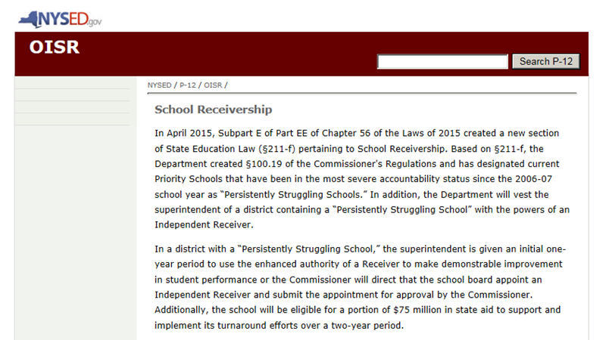
School Receivership Website: Regulations, Requirements, Grants etc.
For Receivership Schools regulations, requirements, grants, resources etc., please visit:
http://www.p12.nysed.gov/oisr/Receivership.html

Slide 31
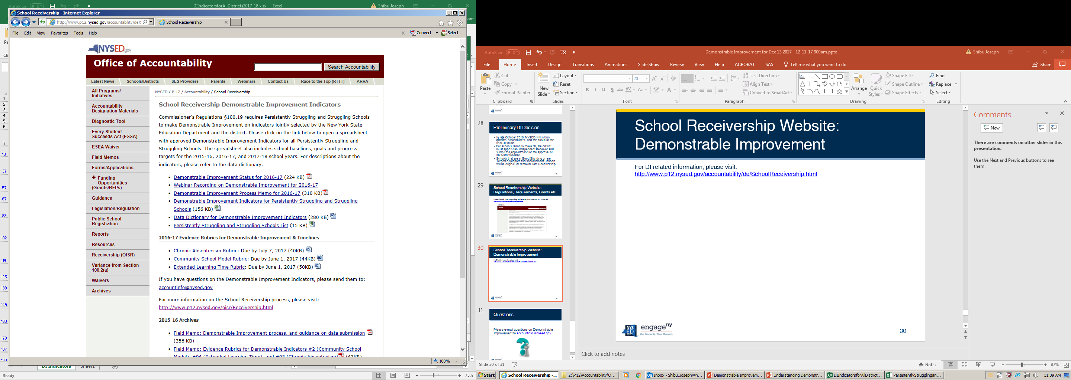
School Receivership Website: Demonstrable Improvement
For DI related information, please visit: http://www.p12.nysed.gov/accountability/de/SchoolReceivership.html

Slide 32
Questions
Please e-mail questions on Demonstrable Improvement to accountinfo@nysed.gov.

